Slide 1

Est. 2005

Slide 2

Open Source
Enterprise Integration Platform
May 2019
Info@ikasan.org

Slide 3
Introduction
The Problem Domain
Architecture Strategies
Translating the Architecture
Ikasan Services
Business Application Integration
Technology Stack
Ikasan Releases
Resources

Slide 4
The Problem Domain
Domain
Enterprise Application Integration (EAI) space
integration of business systems in a landscape of interwoven and often complex finance processes
Issue
EAI is complex, costly, & not the primary business concern
greater adoption of “Best of Breed” specialist applications
business applications distributed across disparate platforms
business data distributed across isolated silos
legacy data repositories
data duplication and integrity issues
no clear business data owner
exponential integration requirements
greater complexity of business demand on data orchestration
EAI is more than simply connecting applications
Goal
To provide simple, robust, configurable commoditised solutions
expose business artifacts whilst isolating the integration specifics

Slide 5
Architecture Strategies
Simplicity
must not require in-depth proprietary knowledge
avoidance of overly complex or heavyweight frameworks
highly testable simple constructs
Commonality
reusable interchangeable constructs
standard contracts of interaction
simple repeatable implementation steps
Adaptability
ability to support any type of business entity
ability to integrate any type of Enterprise Information System
without breaking the first two strategies of Simplicity & Commonality
Robust & Guaranteed operation
maintain data integrity in business delivery and failure scenarios
require minimal manual intervention i.e. failure / automated recovery
clear contract definition and separation of concerns

Slide 6

Architecture Strategies
clear contract definition and separation of concerns
application concerns
application
application
performant, robust & guaranteed operation

Slide 7

Architecture Strategies
clear contract definition and separation of concerns
application concerns
data concerns
data
presentation of standard, meaningful business data
data
application
application
performant, robust & guaranteed operation

Slide 8

Architecture Strategies
clear contract definition and separation of concerns
application concerns
data concerns
business process concerns
process
business event & entity orchestration (STP is the goal)
process
data
presentation of standard, meaningful business data
data
application
application
performant, robust & guaranteed operation

Slide 9
Architecture Strategies
Loose coupling
integrations should only require knowledge of each other through exchange of business artifacts
Tight cohesion
an integration’s specifics must not bleed out unnecessarily
High visibility
business data tracking
fail scenarios
operational audit
Single logical point of integration
geographically agnostic / cross platform support
Open standards aligned with proven design patterns
adoption of industry standard Enterprise Design Patterns avoidance of vendor lock-in
Ensure traceability from architecture through to implementation
all too often architecture fails to translate into the real world
the right architecture can reduce complexity and drive down cost of change and support
process
data
application

Slide 10
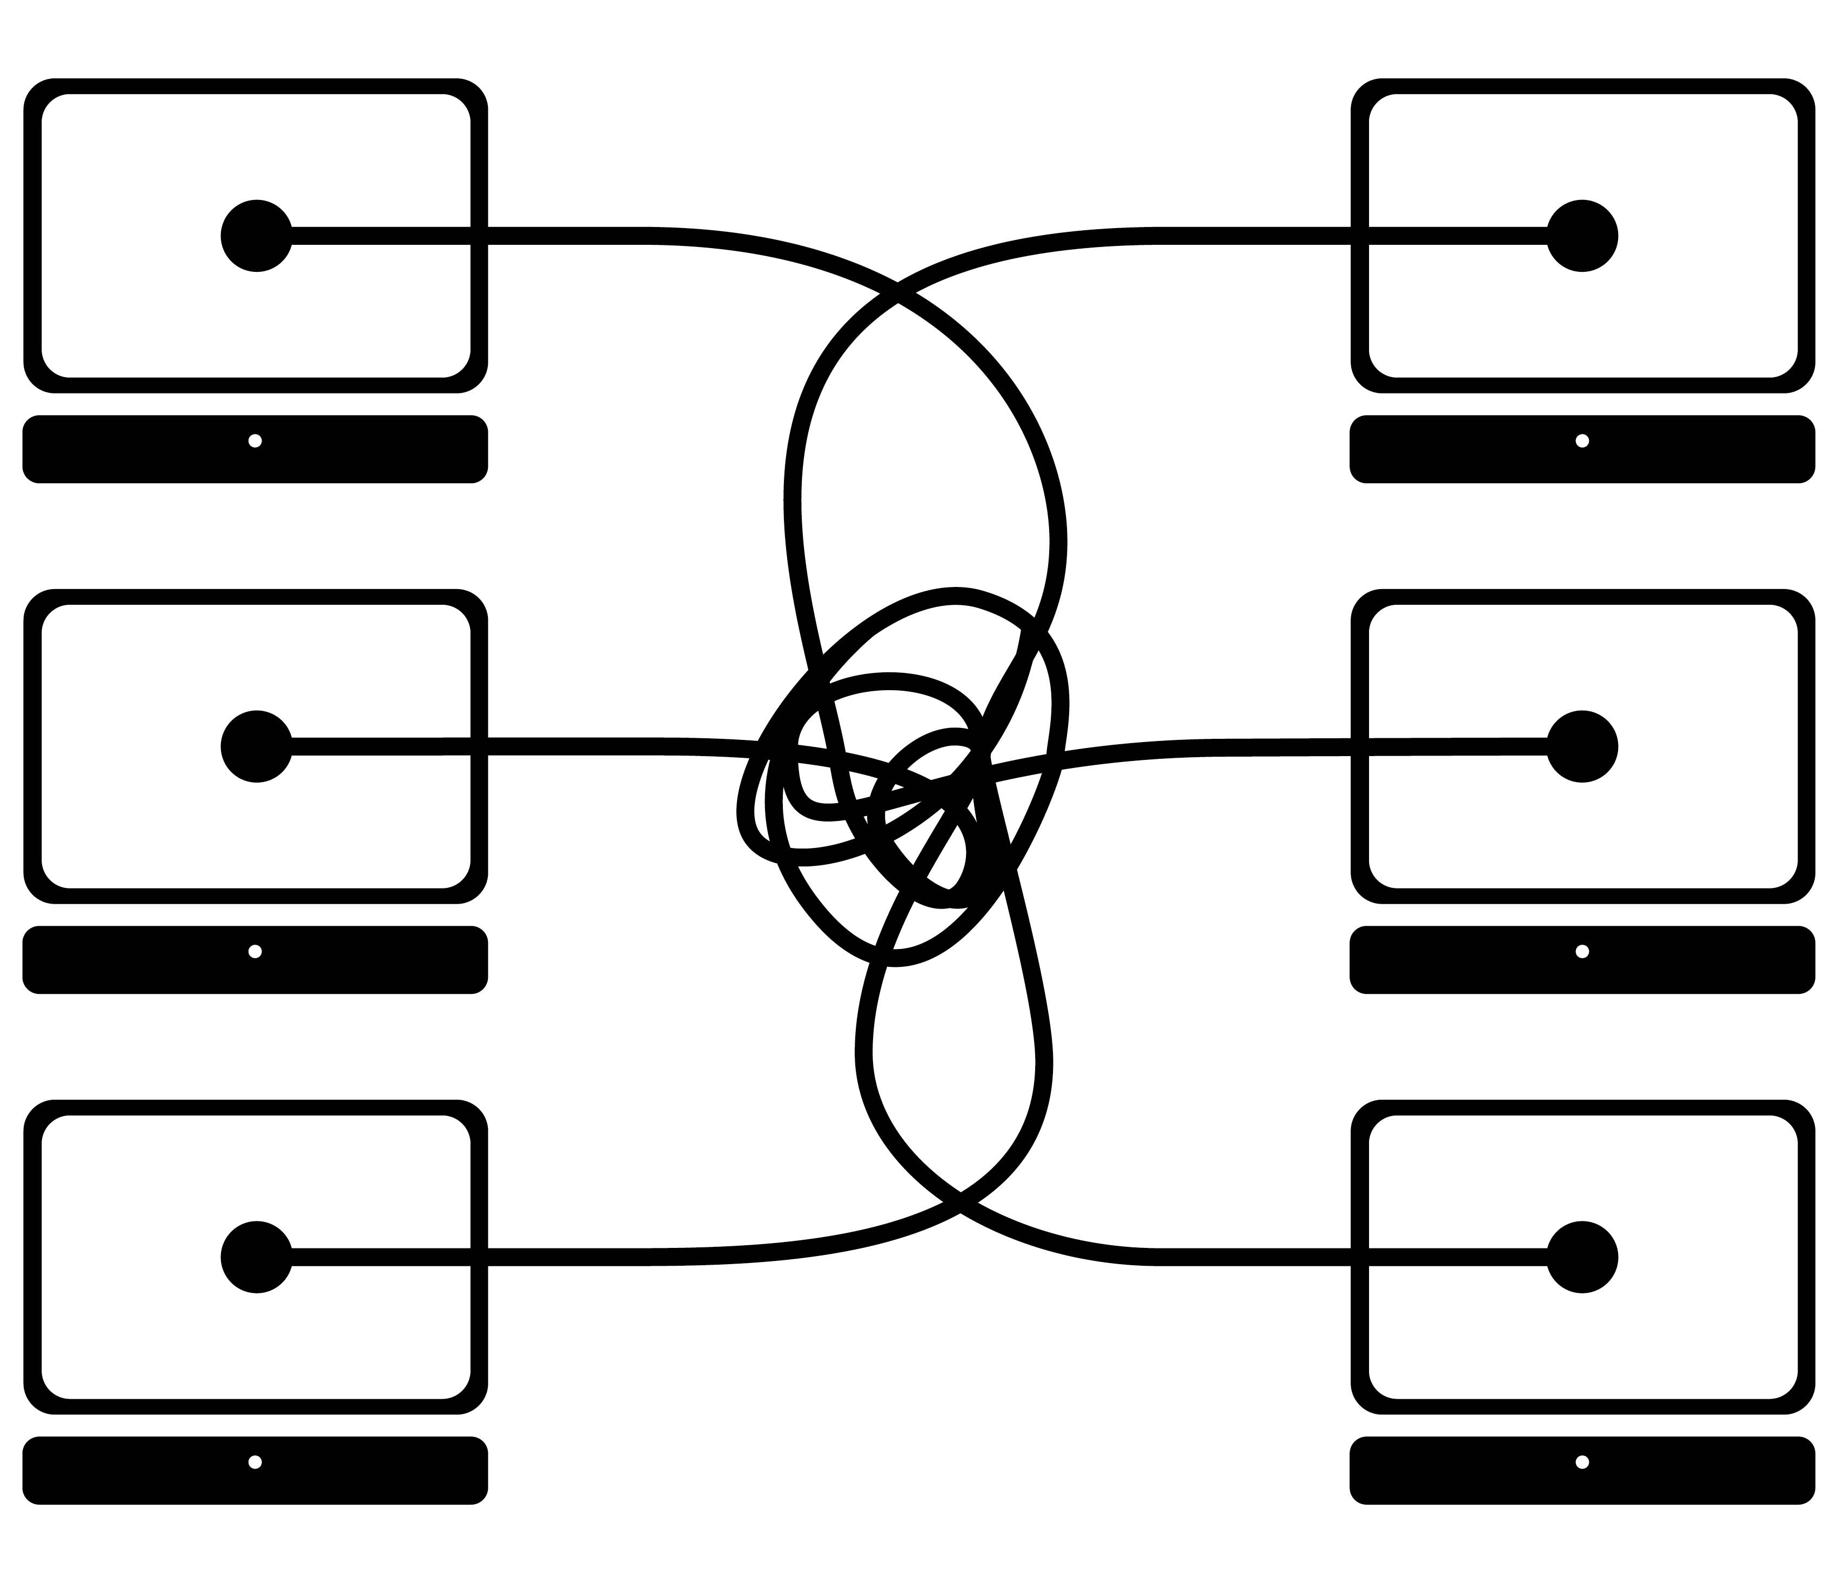
Translating the Architecture
Commonly agreed that “spaghetti integration” is bad
integration can be exponentially complex
bleed out of APIs, data syntax and business semantics
ripple effect of change is massive
process
data
application

Slide 11

Translating the Architecture
Standard Enterprise Application Integration (EAI) approach
provision of an Event/Service backbone
single point of integration for EIS business flow
ripple effect of change is localized (assuming best practice)
process
data
application

Slide 12
Translating the Architecture
Standard Enterprise Application Integration (EAI) approach
First Steps
understand your end to end business streams
understand the participating domains
define and model your enterprise domain
model entities as data & behavior
anemic entities (data only) decay over time
leverage existing domain knowledge
industry standards likely exist
Enterprise Integration Design Patterns
Enterprise Application Design Patterns
identify the integration contract touch points
define IkasanESB Integration points
process
data
application

Slide 13
Translating the Architecture
IkasanESB Integration Modules
provide a grouping of like business application operations
single logical integration point
supports sourcing, distribution, and bi-directional event data
built and run as a self-contained service
Key Strategies
single point integration
loose coupling
variety of standard contracts
separation of concerns
tight cohesion
standard design patterns
interchangeable constructs
highly testable constructs
data integrity
management & control
monitor & alerting
minimal manual intervention
support any protocol/entity
business event tracking
operational audit
data
data
application
data
application

Slide 14

Translating the Architecture
IkasanESB Flows
flows belong to an Integration Module
provide cohesive, atomic operations on business artifacts
multiple flows can be chained to isolate concerns
standard event container allows any data type to be transported
Key Strategies
single point integration
loose coupling
variety of standard contracts
separation of concerns
tight cohesion
standard design patterns
interchangeable constructs
highly testable constructs
data integrity
management & control
monitor & alerting
minimal manual intervention
support any protocol/entity
business event tracking
operational audit
flow
flow
flow

Slide 15
Translating the Architecture
IkasanESB Flow Components
belong to a Flow
POJO implementations provide independent, interchangeable operations
isolated white box testing and chained black box testing
unfettered event transport without overhead of casting or serialization
Key Strategies
single point integration
loose coupling
variety of standard contracts
separation of concerns
tight cohesion
standard design patterns
interchangeable constructs
highly testable constructs
data integrity
management & control
monitor & alerting
minimal manual intervention
support any protocol/entity
business event tracking
operational audit

Slide 16
Translating the Architecture
IkasanESB Flow Contracts
management API for business flow control (start, stop, pause, resume)
runtime status API for real-time health (running, stopped, recovering, error)
monitor API for pluggable health notification as real-time alerting
recovery manager for configurable exception handling & automated recovery
Key Strategies
single point integration
loose coupling
variety of standard contracts
separation of concerns
tight cohesion
standard design patterns
interchangeable constructs
highly testable constructs
data integrity
management & control
monitor & alerting
minimal manual intervention
support any protocol/entity
business event tracking
operational audit
stop()
start()
pause()
resume()
getStatus()

Slide 17
Translating the Architecture
IkasanESB Component Types
consumers are always the starting component for any flow
consumers can support any type of protocol
extend guaranteed integrity to non-guaranteed EIS sources/targets
no proprietary knowledge required – only EIS API
API adaptors are pluggable and re-useable components
API support can be 3rd party off-the-shelf or custom developed
Key Strategies
single point integration
loose coupling
variety of standard contracts
separation of concerns
tight cohesion
standard design patterns
interchangeable constructs
highly testable constructs
data integrity
management & control
monitor & alerting
minimal manual intervention
support any protocol/entity
business event tracking
operational audit

Slide 18
Translating the Architecture
IkasanESB Component Types
any number of components can operate on data following a consumer
converter
translator
splitter
filter
sequencer
broker
single-recipient router
multi-recipient router
producer
Key Strategies
single point integration
loose coupling
variety of standard contracts
separation of concerns
tight cohesion
standard design patterns
interchangeable constructs
highly testable constructs
data integrity
management & control
monitor & alerting
minimal manual intervention
support any protocol/entity
business event tracking
operational audit

Slide 19
Translating the Architecture
IkasanESB Component Types
producer components always end a flow
several producers may exist in the flow if the flow has branched routes
Key Strategies
single point integration
loose coupling
variety of standard contracts
separation of concerns
tight cohesion
standard design patterns
interchangeable constructs
highly testable constructs
data integrity
management & control
monitor & alerting
minimal manual intervention
support any protocol/entity
business event tracking
operational audit

Slide 20








Translating the Architecture
IkasanESB Dashboard
single pane view of the entire IkasanESB Integration Module estate
management and administration for all services including
user/group principals, roles, and policies
configuration of Integration Modules, flows, and components
sub-second searches of data events across the entire estate
errors, exclusions, resubmissions, and event recording and replay
typically used by IT support and business teams
Key Strategies
single point integration
loose coupling
variety of standard contracts
separation of concerns
tight cohesion
standard design patterns
interchangeable constructs
highly testable constructs
data integrity
management & control
monitor & alerting
minimal manual intervention
support any protocol/entity
business event tracking
operational audit
process

Slide 21
Ikasan Services
Ikasan Standard Services
standard services are automatically included with each Integration Module
service contracts are pluggable, so replacing default implementation with custom is possible
standard services are summarised below
process
Management Service
Record & Replay Service
Hospital Services
Mapping Service
Configuration Service
Wiretap Service
Monitoring Service

Slide 22
Ikasan Services
Management Service
management service endpoints are available across all Ikasan artefacts
Ikasan Dashboard provides a single pane view of all Integration Modules and management therein
REST API service access for automation of calls to services
process
flow management for runtime control and status
user management authentication and authorisation per service
event management across services
deployment controls
audit logs
application

Slide 23
Ikasan Services
Record & Replay Service
supports event recording per flow
events can be replayed to this or another Ikasan instance
invaluable for EIS business system crash/recovery or production data replay to test environments
process
any data event can be recorded and replayed as if from source
event data can be recorded in one environment and replayed to another
replay can occur in the normal event flow, or normal event flow paused whilst replay is in progress
replay is authenticated/authorised and fully audited
application

Slide 24
Ikasan Services
Hospital Services
error reporting service provides visibility of all errors
exclusions service allows individual bad events to be removed from the flow
resubmission service supports the resubmission of previously error events back into the flow
process
any technical or business data errors within the flow get logged to the Error Reporting Service
business data errors which may block other events can be excluded and parked for user attention
any excluded event may be resubmitted back into the normal flow
all services above are visible and managed through the Ikasan Dashboard
application

Slide 25
Ikasan Services
Mapping Service
provides event attribute mapping as part of data transformation
process
supports simple and complex relationships – 1:1, 1:n, n:1, n:n
mappings can be defined, named, and reused across the estate
runtime configuration that doesn’t require build or deployment
all mappings are visible and managed through the Ikasan Dashboard
application

Slide 26
Ikasan Services
Configuration Service
allows runtime configuration for all Ikasan artefacts i.e. components, flows, monitors
process
supports standard CRUD operations across all configurations
runtime configuration that doesn’t require build or deployment
configurations may be imported and exported as XML or JSON
all configurations are visible and managed through the Ikasan Dashboard
application

Slide 27
Ikasan Services
Wiretap Service
dynamic capture of real-time in-flight events at any point within the platform
process
supports text content searching across millions of captured events sub-second
typically used for support and troubleshooting
end to end lineage of data events regardless of transformations or system exit/re-entry
all configurations are visible and managed through the Ikasan Dashboard
application

Slide 28
Ikasan Services
Monitor Service
capture any state change in runtime flows i.e. stopped, paused, running, recovering, error
notifiers connect to external Enterprise Monitoring tools to report state changes
process
default monitor reports any runtime flow state change in real-time
custom monitors can be easily added
notifiers push notifications of runtime change to any API i.e. Email, Solarwinds, Zenoss, HTTP
all configurations are visible and managed through the Ikasan Dashboard
application

Slide 29

Business Application Integration
Post Trade Execution
Bloomberg
Trade Feed
Consolidated Message Feed
Derivative Settlement Feed
Daily Trade Reporting
PATS
Espeed
TradeWeb
ION, Anvil, & Fidessa
Positions
ION
Bloomberg
Intellimatch
Price Marks
ION
Bloomberg

Slide 30
Business Application Integration
Trade Matching, Reporting & Reconciliation
TRAX
Bloomberg Daily Trade Reporting
Sales Commission Reporting
FIOS
Reference Data
Bloomberg Data License Per Security; Data License Back Office
MACE Convertible Bonds
Swap Monitor Financial Calendar
Fidessa ETP and ATP
GoldenSource
Market Data
Markit CDS Service
Markit iBoxx Benchmark Indices
Asset Control
Bank of America Merrill Lynch Indices

Slide 31
Business Application Integration
Settlements & Operations
SWIFT Alliance
GlobOp
Ratings
Moodys
Standard & Poors
Fitch
Compliance
Thomson Reuters TransWatch Securities Data
B-Next
Corporate Actions
FTI Corporate Action & Securities Universe

Slide 32
Technology Stack
Development Stack
Core Technologies
Java 1.8+
SpringBoot
Test Frameworks
JUnit
JMock
SpringBootTest
Ikasan Flow Test Harness
Scaffolding
source management, peer review, acceptance management – GitHub
requirements and issues management – Jira
project build management – Maven
project artefact management – Sonotype Nexus
continuous integration – Travis

Slide 33
Technology Stack
Ikasan Runtime Stack
IkasanESB Application
Ikasaneip-2.x – engine underpinning all operations and services
IkasanESB Optional Enterprise Modules
Ikasan-test-component – endpoint components for test event generation
Persistence
any Enterprise relational database
H2 database is shipped by default in the samples and Maven archetypes
Ikasan Dashboard
single pane view for all runtime Ikasan Integration Modules
High Availability
Ikasan is tested/ratified to run in Docker containers as part of a Kubernetes managed platform

Slide 34
Technology Stack
Off-the-shelf Integration
JMS (HornetQ, JBossA-MQ, ActiveMQ, IBM MQ, WebLogic)
FTP (transactional & chunking support)
SFTP (transactional & chunking support)
RDBMS
MQ Client
FIX
SMTP
HTTP(s)
MongoDB
Kxdb
HDFS & Parquet
Custom Component Development
very simple to create custom integrations specific to an upstream or downstream API
all components adhere to standard contracts
developed as standard Java 1.8+

Slide 35
Technology Stack
Flow Non-Functional Features
High performance single threaded throughput
core engine benchmarked at 3million events per second
Supports full transaction semantics
non-transactional resources
local transactional resources
2-phase transactional resources
last resource commit optimisation (LRCO)
Configurable automated runtime recovery from technical and data failures
rollback operations and stop
rollback operations and retry
rollback and exclude bad data event
report the issue and continue

Slide 36
Technology Stack
Development times are a function of either complexity or volume
functionally complex Integration Modules will naturally take longer to implement and test than simple ones
a simple Integration Module containing 10 flows will take longer than one with 2 flows
Ikasan Integration Module implementation guide
The following are provided as indicative efforts only
low complexity based on Maven archetypes
1 day for a simple Integration module containing a 1-2 flows consisting of 3-4 components each
3 days for a simple integration module containing 3 flows consisting of 5 components each
moderate complexity based on Maven archetypes
1 – 10 days for an Integration module containing a 3-5 flows each of which has 5-10 components
high complexity
15 – 20 days for a complex module containing 6-8 flows each of which has 10-15 components
20 – 30 days for a complex module containing 8+ flows each of which has 15+ components

Slide 37
Ikasan Releases
Bug Fix Releases
ad-hoc for emergencies
monthly
Minor Releases
quarterly
Major Releases
half yearly
Release Compatibility
all Ikasan releases are compatible with previous releases from Ikasan v2.0.0 onwards
any updates / migrations within the Ikasan private persistence are automated on deployment
multiple versions of Ikasan can run similtaneously

Slide 38
Resources
Web Site
http://www.ikasan.org
GitHub
https://github.com/ikasanEIP/ikasan
Jira / Confluence
https://ikasan.atlassian.net/projects/IKASAN
Developer Guides
https://github.com/ikasanEIP/ikasan/blob/master/ikasaneip/developer/docs/StandaloneDeveloperGuide.md
Contact
info@ikasan.org

